Slide 1

Advanced E-commerce Recommendation System
Presentation by:
Anuroop Gowda C
N Niveditha
Sharath M

Slide 2
Introduction
This project aims to develop an advanced E-commerce recommendation platform where users can seamlessly switch between two roles: Buyer and Seller.
The platform enables buyers to browse and purchase products while also offering the functionality for sellers to list, edit, delete, and manage their own products. Additionally, buyers can manage their shopping cart, view products added by sellers, and update their shipping address.
The system supports a unique feature called "switch user," which allows users to toggle effortlessly between buyer and seller roles. This platform provides a more interactive and flexible user experience in the context of e-commerce.

Slide 3
Problem Statement
Many existing e-commerce platforms require users to create and manage separate accounts for buying and selling, leading to inefficiencies and a fragmented user experience. The need to repeatedly log in and out to access different roles disrupts workflow and complicates order and product management. Our project addresses these challenges by implementing a unified, dual-role system that offers a seamless, integrated experience for both buyers and sellers, enhancing overall user satisfaction and operational efficiency.

Slide 4
Objectives
User Authentication: Implement an authentication system that allows users to register and login as either a buyer or seller. Each user should be able to access relevant features based on their role.
Role Switching: Implement a seamless "switch user" feature that allows users to switch between their buyer and seller accounts without needing to logout and login again.
Product Management for Sellers: Enable sellers to add, edit, and delete their products. They should also be able to view the orders placed by buyers for their products.
Shopping Experience for Buyers: Allow buyers to browse products, add them to their cart, purchase products, and manage their address information.
Buy and Cart Functionality: Buyers can purchase single or multiple products, add them to their cart, and apply coupon codes at checkout.
Review Analysis: Clicking on a product image suggests “Good” or “Not Recommended” based on past reviews.

Slide 5
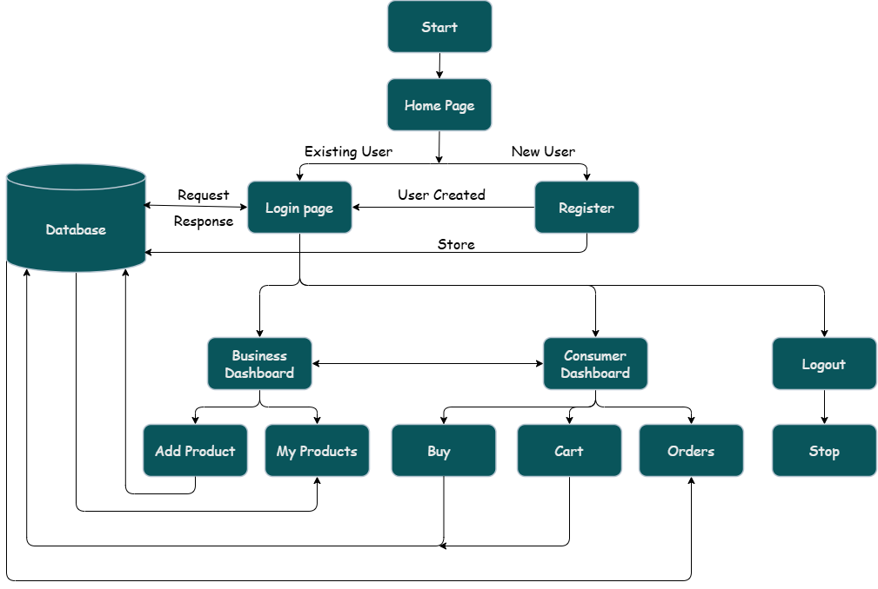
Flow Chart

Slide 6
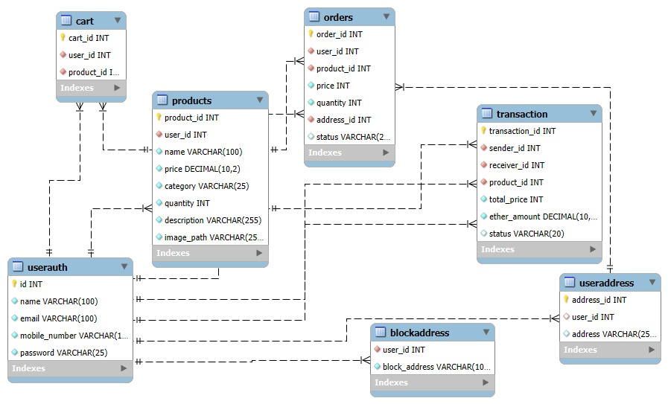
ER Diagram

Slide 7
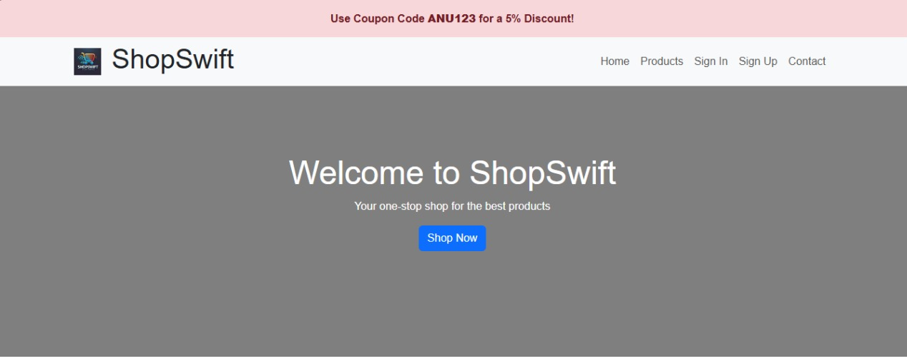
Result
Fig 1: Home page

Slide 8
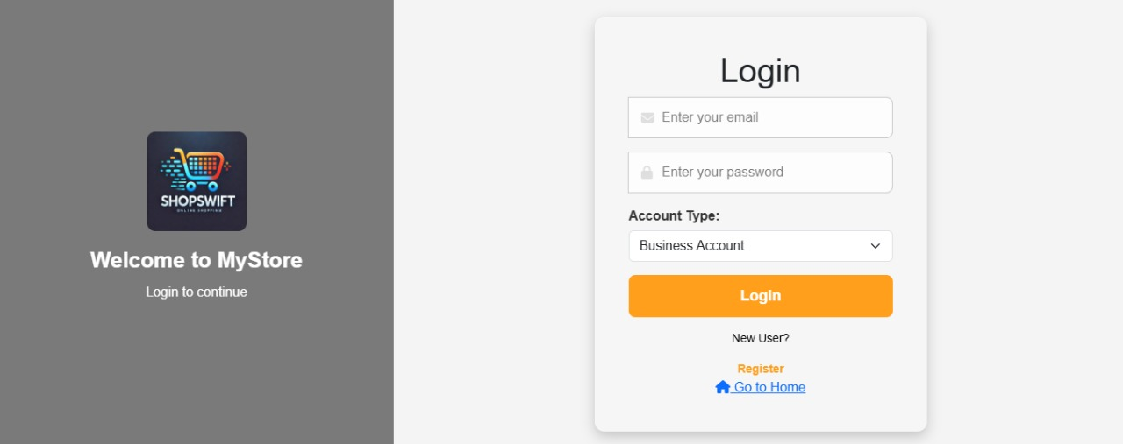
Result
Fig 2: Login page

Slide 9
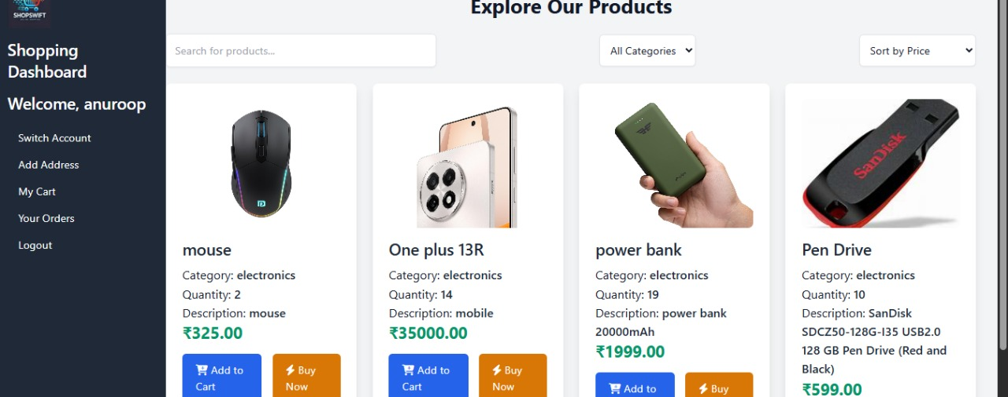
Result
Fig 3: Shopping dashboard page

Slide 10
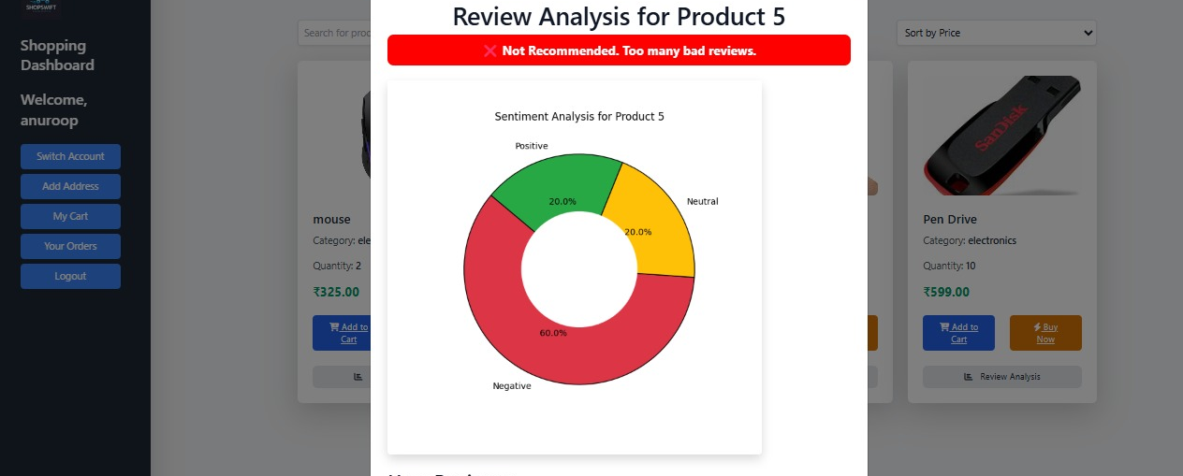
Result
Fig 4: Review Analysis Page

Slide 11
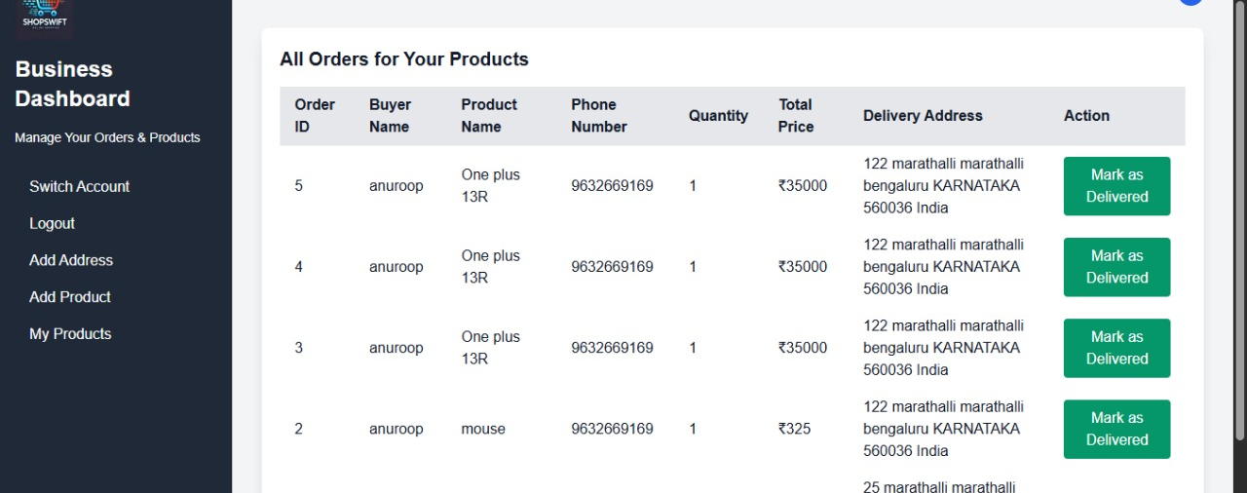
Result
Fig 5: Business dashboard page

Slide 12
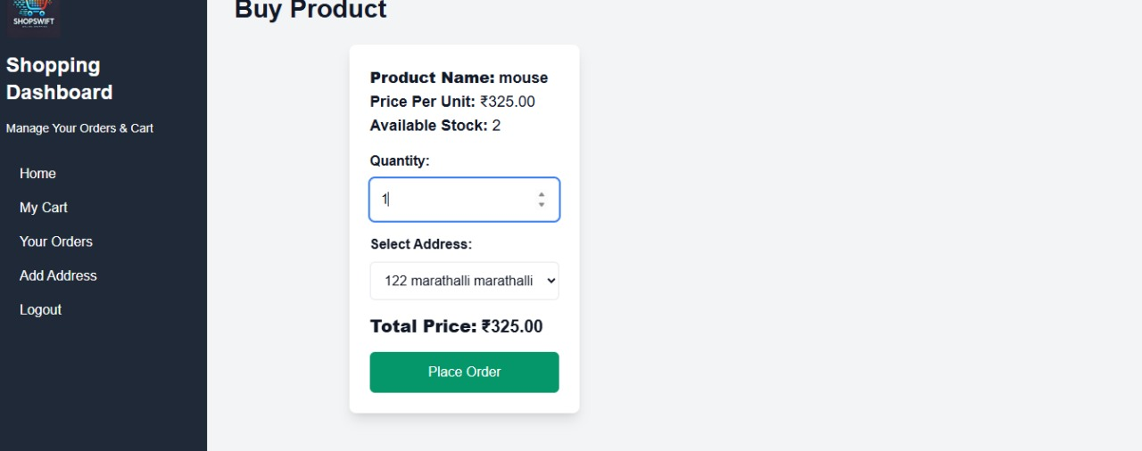
Result
Fig 6: Buy section

Slide 13
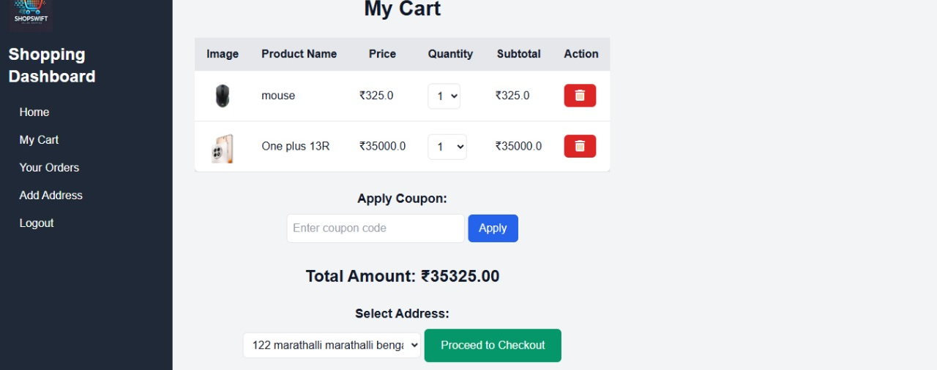
Result
Fig 7: Cart page

Slide 14
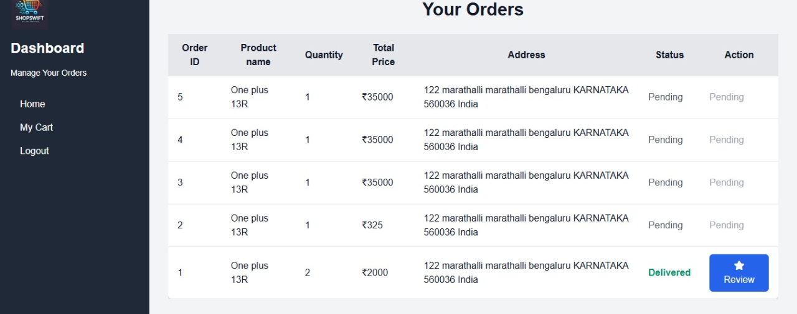
Result
Fig 8: Consumer orders page

Slide 15
Result
Fig 9: Placed order page from consumer

Slide 16
Future Scope
Integration with Payment Gateways
Secure Online Payments: Integrate Razorpay, Stripe, or PayPal for online transactions.
Cash on Delivery (COD): Offer flexible payment options for users.
AI-Based Recommendation System
Personalized Shopping Experience – AI will recommend products based on user preferences, past purchases, and browsing behavior.
Smart & Real-Time Suggestions – AI will analyze real-time data to suggest trending, relevant, and best-matching products instantly

Slide 17
Conclusion
The Advance E-commerce Recommendation System built using Flask and MySQL, successfully demonstrates the development of a functional and user-friendly web application tailored for both consumers and businesses. The project highlights the seamless integration of frontend and backend technologies to create a robust system that addresses real-world e-commerce needs.

Slide 18
Thank you

